Slide 1
Texture
Some slides: courtesy of David Jacobs

Slide 2
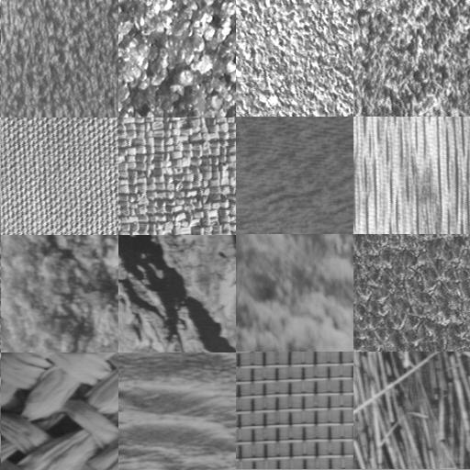
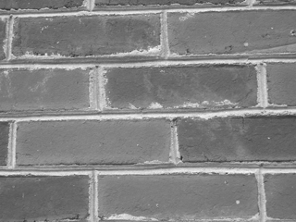
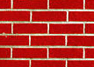

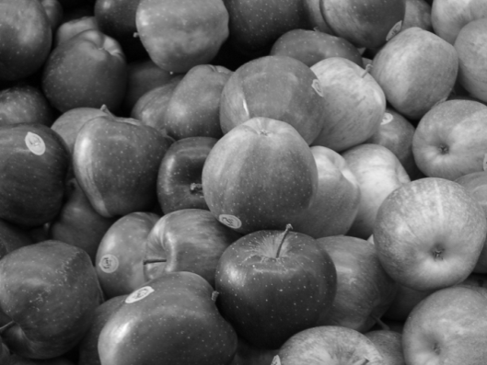
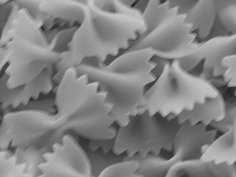
Examples
Simple textures (material classification): Brodatz dataset
More general textures on unstructured scenes
Dynamic textures

Slide 3
Applications
Classification (Objects and Scene, Material)
Segmentation: group regions with same texture
Shape from texture: estimate surface orientation or shape from texture
Synthesis ( Graphics) : generate new texture patch given some examples

Slide 4
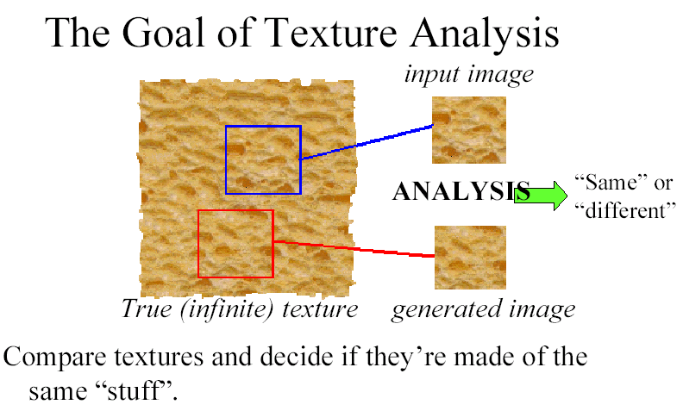
Issues: 1) Discrimination/Analysis
(Freeman)

Slide 5
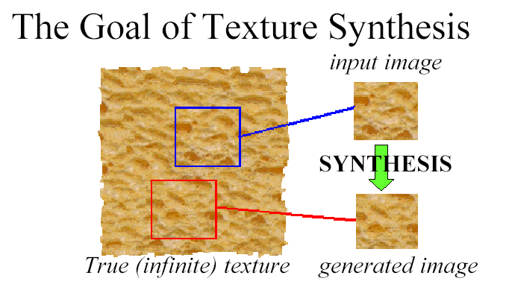
2) Synthesis

Slide 6
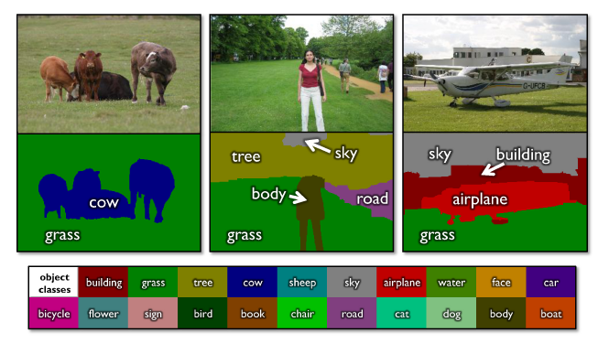
Texture for Scene classification
TextonBoost (Shotton et al. 2009 IJCV)

Slide 7
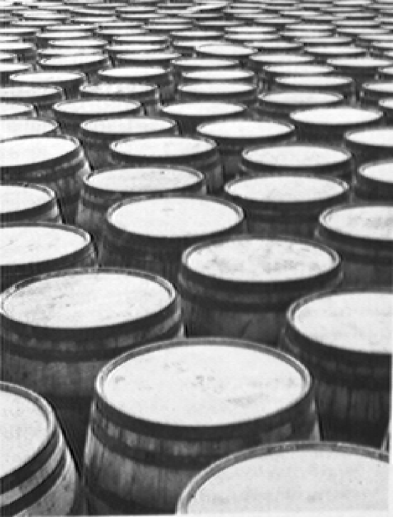
Texture provides shape information
Gradient in the spacing of the barrels (Gibson 1957)

Slide 8
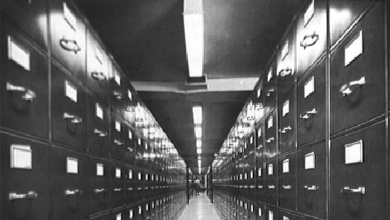
Texture gradient associated to converging lines (Gibson1957)

Slide 9
Shape from texture
Classic formulation: Given a single image of a textured surface, estimate the shape of the observed surface from the distortion of the texture created by the imaging process
Approaches estimate plane parameters,
Require restrictive assumptions on the texture
isotropy (same distribution in every direction) and orthographic projection
Homogeneity (every texture window is same)

Slide 10
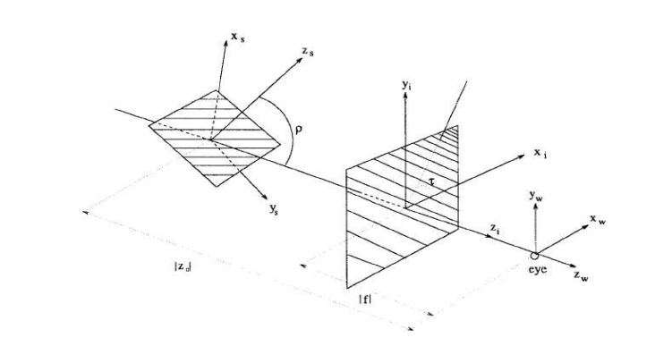
slant
tilt

Slide 11
Texture description for recognition
Two main issues
1. Local description: extracting image structure with filters (blobs, edges, Gabors, or keypoint descriptors) ; different scales
2. Global description:
- statistical models (histograms or higher order statistics, MRF )
- Some models (networks, ant systems, etc.)

Slide 12
Why computing texture?
Indicative of material property -> attribute description of objects
Good descriptor for scene elements
For boundary classification: need to distinguish between object boundary and texture edges

Slide 13
Overview
Local: Filter selection and scale selection for local descriptors
Global: Statistical description: histogram
MFS (multifractal spectrum): invariant to geometric and illumination changes
Edge classification using texture and applying it shadow detection

Slide 14
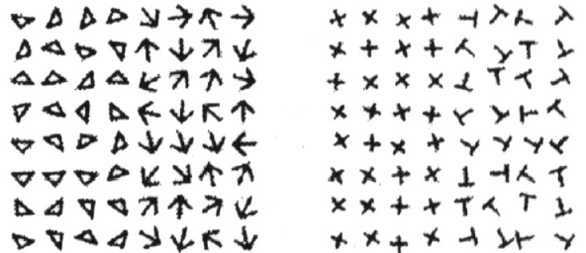
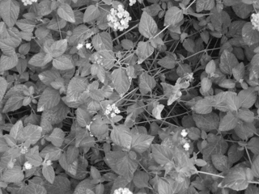
Local descriptors: motivation
Ideally we think of texture as consisting of texture elements (Textons)
Since in real images there are no canonical elements, we apply filter
that pick up “blobs” and “bars”

Slide 15
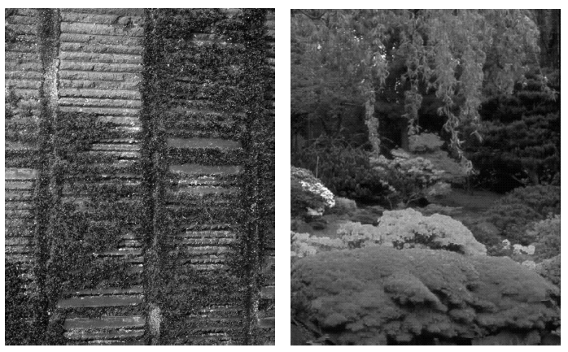
Example (Forsyth & Ponce)

Slide 16
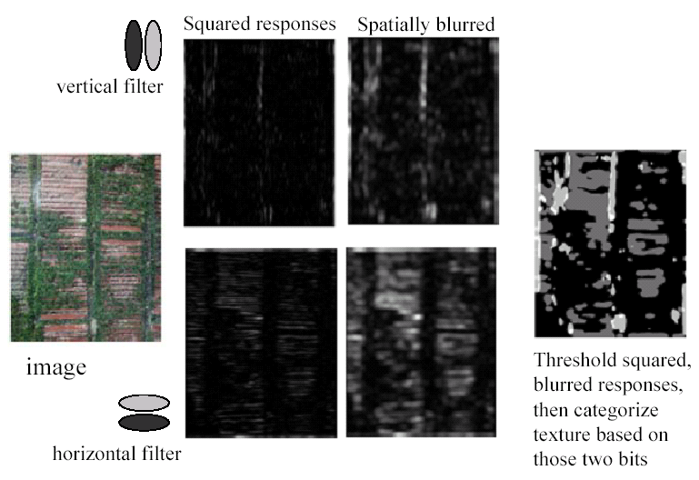
classification

Slide 17
What are Right Filters?
Multi-scale is good, since we don’t know right scale a priori.
Easiest to compare with naïve Bayes:
Filter image one: (F1, F2, …)
Filter image two: (G1, G2, …)
S means image one and two have same texture.
Approximate: P(F1,G1,F2,G2, …| S)
By P(F1,G1|S)*P(F2,G2|S)*…

Slide 18
What are Right Filters?
The more independent the better.
In an image, output of one filter should be independent of others.
Because our comparison assumes independence.
Wavelets seem to be best.

Slide 19
Blob detector
• A filter at multiple scales.
• The biggest response should be when
the filter has the same location and
scale as the blob.

Slide 20
Center Surround filter
+
• When does this have
biggest response?
• When inside is dark
•And outside is light
• Similar filters are in humans and animals
-
+

Slide 21
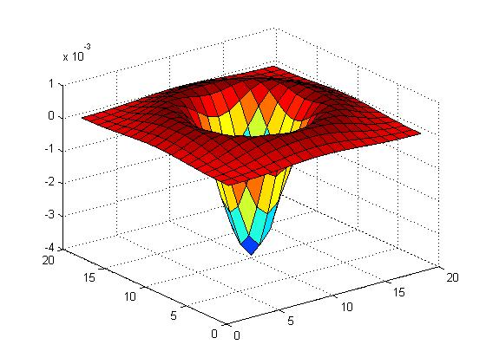

Blob filter
Laplacian of Gaussian: Circularly symmetric operator for blob detection in 2D
Need to scale-normalize:

Slide 22
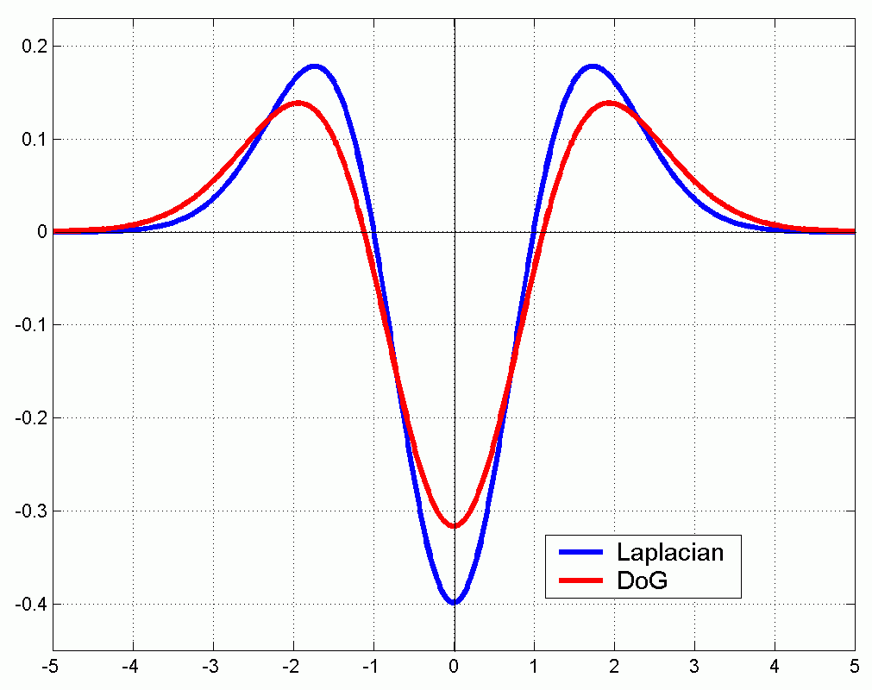
Efficient implementation
Approximating the Laplacian with a difference of Gaussians:
(Laplacian)
(Difference of Gaussians)

Slide 23
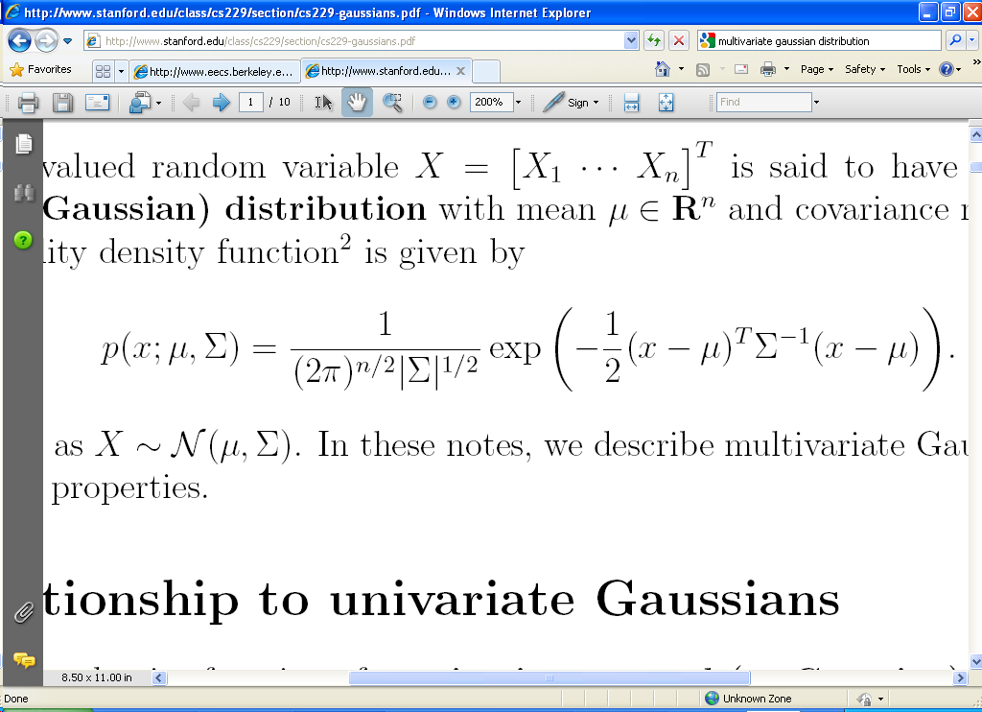
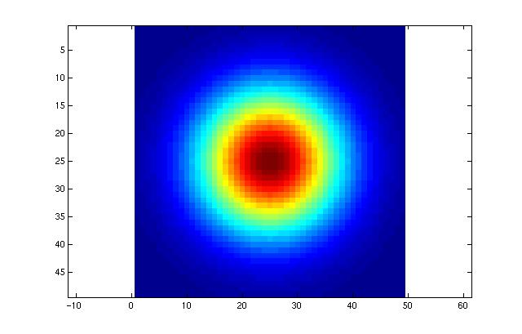
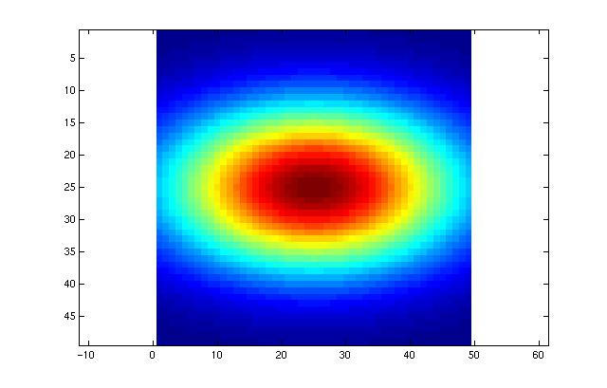
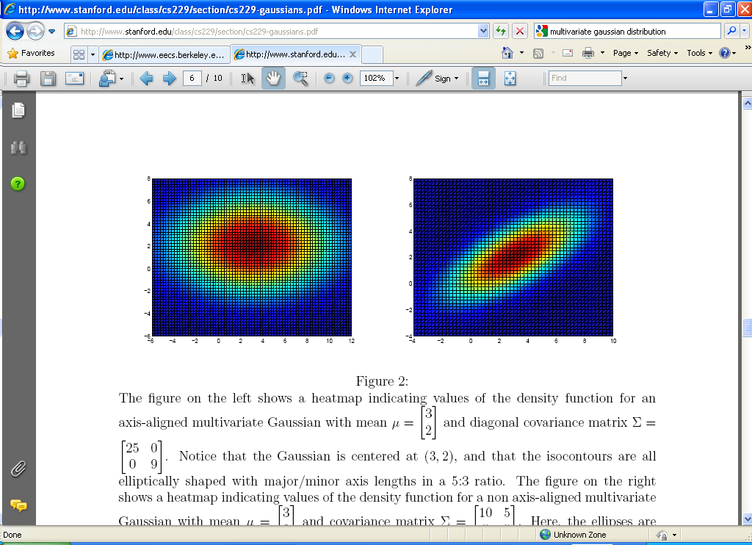
Multivariate Gaussian

Slide 24
Difference of Gaussian Filters

Slide 25
Spots and Oriented Bars (Malik and Perona)

Slide 26

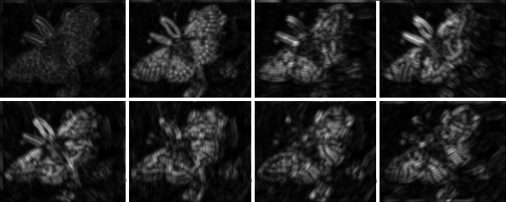
Applying these eight filters to the butterfly image

Slide 27
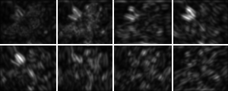
At fine scale
At coarser scale

Slide 28
Filter banks
We apply a collection of multiple filters: a filter bank
The responses to the filters are collected in feature vectors, which are multi-dimensional.
We can think of nearness, farness in feature space

Slide 29
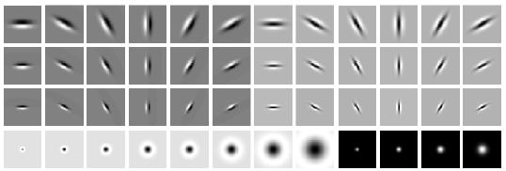
Filter banks
orientations
scales
“Edges”
“Bars”
“Spots”
Leung Malik filterbank: 48 filters: 2 Gaussian derivative filters at 6 orientations
and 3 scales, 8 Laplacian of Gaussian filters and 4 Gaussian filters.
What filters to put in the bank?
Typically we want a combination of scales and orientations, different types of patterns.
Matlab code available for these examples: http://www.robots.ox.ac.uk/~vgg/research/texclass/filters.html

Slide 30












Gabor Filters
Gabor filters at different
scales and spatial frequencies
top row shows anti-symmetric
(or odd) filters, bottom row the
symmetric (or even) filters.

Slide 31
Gabor filters are examples of Wavelets
We know two bases for images:
Pixels are localized in space.
Fourier are localized in frequency.
Wavelets are a little of both.
Good for measuring frequency locally.

Slide 32
Global: descriptions
Simplest histograms

Slide 33
Global description: Simplest Texture Discrimination
Compare histograms.
Divide intensities into discrete ranges.
Count how many pixels in each range.
0-25
26-50
51-75
76-100
225-250

Slide 34
High-dimensional features
Often a texture dictionary is learned first by clustering the feature vectors using K-mean clustering.
Histogram, where each cluster is represented by cluster center, called textons
Each pixel is assigned to closest texton
Histograms are compared (often with Chi-square distance)

Slide 35
2. Learning the visual vocabulary
…
Slide credit: Josef Sivic

Slide 36
2. Learning the visual vocabulary
…
Clustering
Slide credit: Josef Sivic

Slide 37
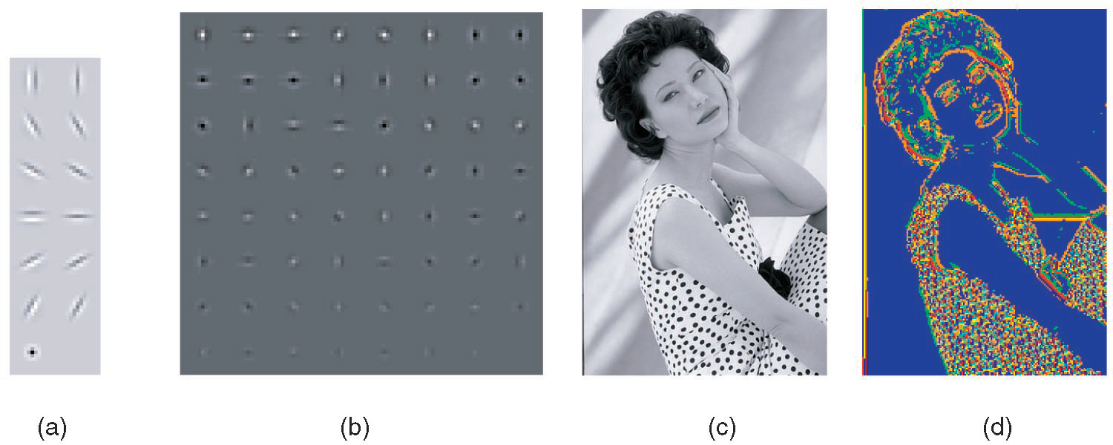
Example of texton dictionary
Filterbank (13 filters)
Universal textons (64)
Image
Texton map (color-coded)
Martin, Fowlkes, Malik, 2004: Berkeley (Pb) edge detector

Slide 38
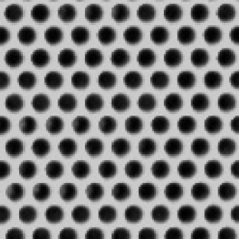

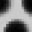

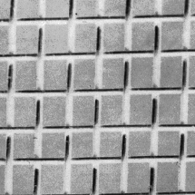
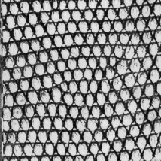
Texture recognition
histogram
Universal texton dictionary
Julesz, 1981; Cula & Dana, 2001; Leung & Malik 2001; Mori, Belongie & Malik, 2001; Schmid 2001; Varma & Zisserman, 2002, 2003; Lazebnik, Schmid & Ponce, 2003

Slide 39
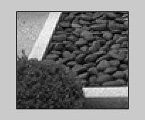
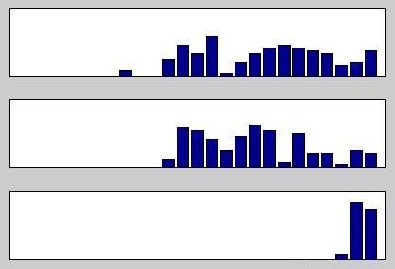
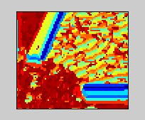
Chi square distance between texton histograms
Chi-square
i
j
0.1
k
0.8
(Malik)

Slide 40
Different approaches
Universal texton dictionaries vs
Different dictionaries for each texture class
Sparse features vs. dense features
Different histogram comparisons
e.g L1 distance
or EMD (earth mover’s distance)

Slide 41
Viewpoint invariant texture description

Slide 42
Multi-fractal spectrum (MFS) texture signature
A framework to combine local and global description based on multi-fractal-spectrum theory
Invariant to surface and view-point changes
Robust to Illumination changes
Compact vector size (~70 vs~1000)
Computational efficient
Simplicity in the implementation
Y. Xu, H. Ji and C. Fermüller, Viewpoint invariant texture description using fractal
Analysis, International Journal of Computer Vision, 2009
Y. Xu,et al , " Scale-space texture description on SIFT-like textons," Computer Vision and Image Understanging, 2012

Slide 43
Fractal dimension
Measurement at scale δ. For each δ we measure an object in a way that ignores regularity of size less than δ, and we see how these measurement behaves as δ goes to 0.
Most natural phenomena satisfy the power law:
an estimated quantity is proportional to
with D a constant
(for example the length of a coastline)
for a point set E in R²
Fractal dimension

Slide 44
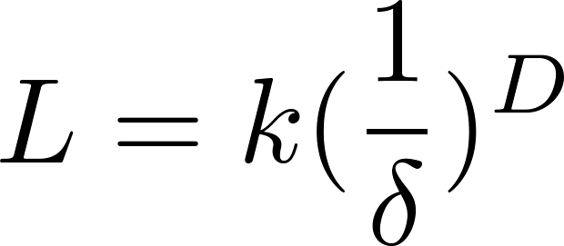

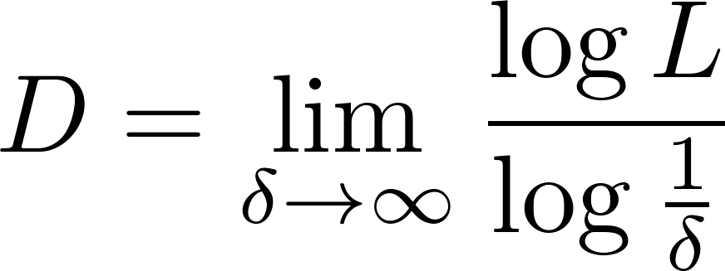
Idea of fractal quantity

Slide 45

Fractal dimension
D = 1 D = 2 D = 1.7

Slide 46
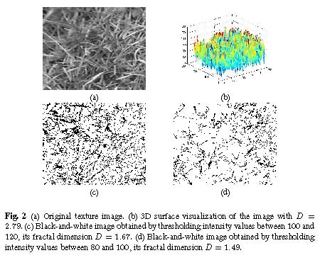
MFS
Extension: divide quantity into a discrete number of sets, compute fd for every set -> MFS. e.g. divide intensity [1, 255] into 26 classes.

Slide 47
Invariance
The MFS is invariant under the bi-Lipschitz transform; basically any smooth function->
translation, rotation, projective transformation, warpings of the surfaces
Illumination variance
Consider the intensity function I(x) piecewise locally linear : a_{k}I(x) + b_{k}
MFS defined on edges is invariant

Slide 48
Basic idea
Multiple MFSs from multiple density functions defined on different local feature spaces.
Local feature spaces
Zero-mean intensity
Gradient energy
Laplacian energy
Spatial distortion invariance
Illumination invariance

Slide 49
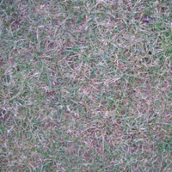
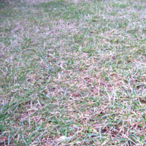
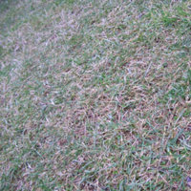
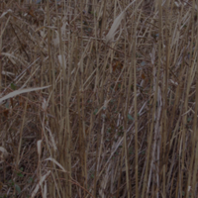
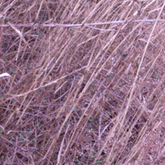
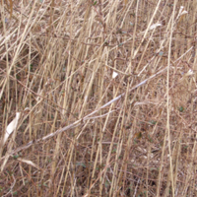
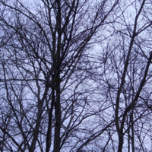
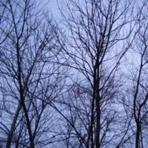
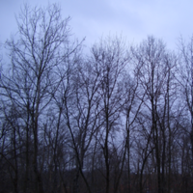
View-point invariance
Grass
Bulrush
Trees

Slide 50
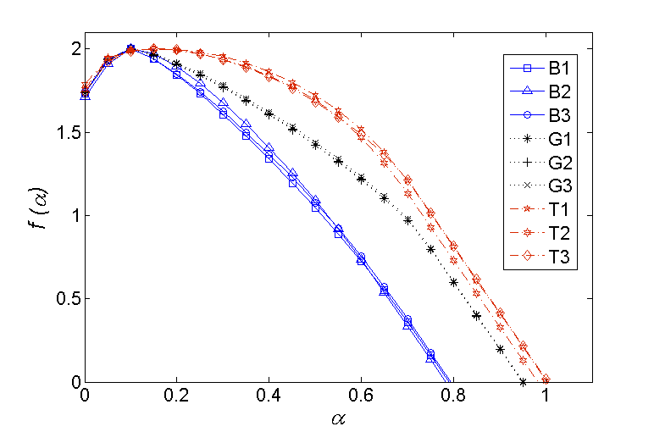
(cont’)
Trees
Brush
Grass
MFS on feature space

Slide 51
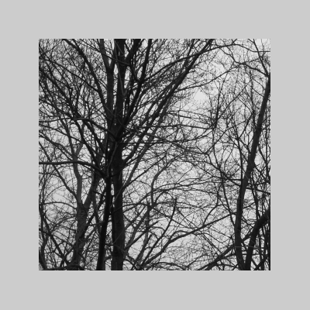
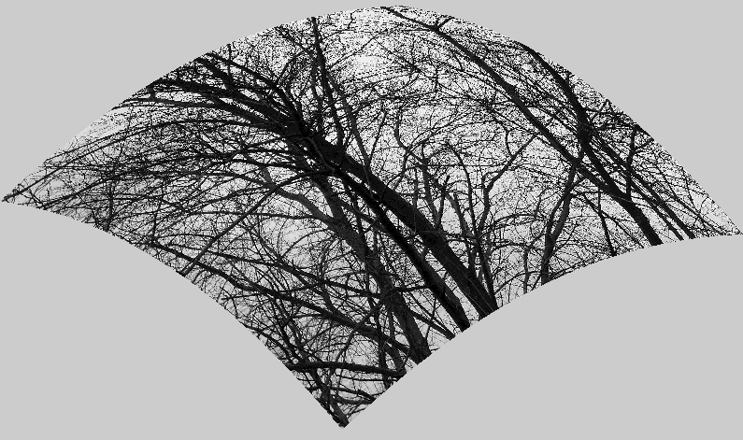
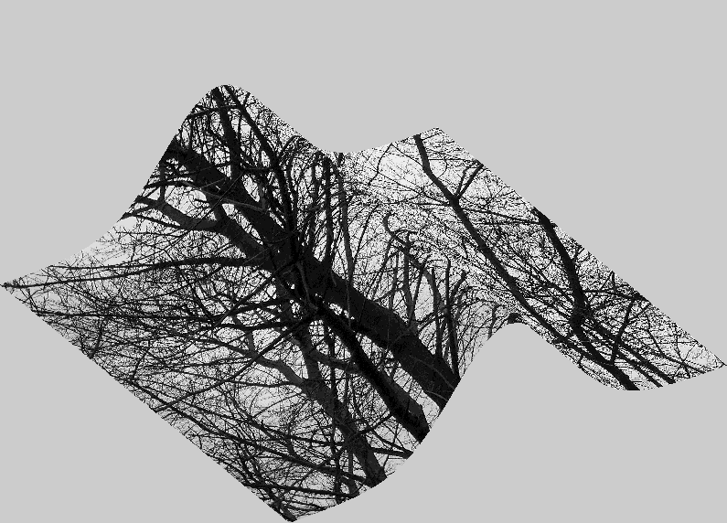
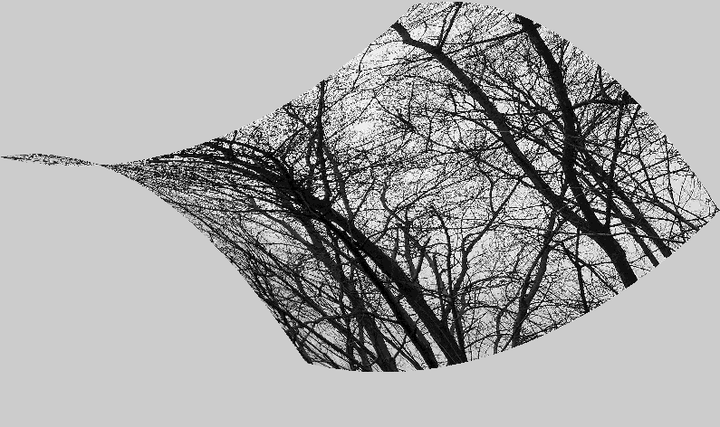
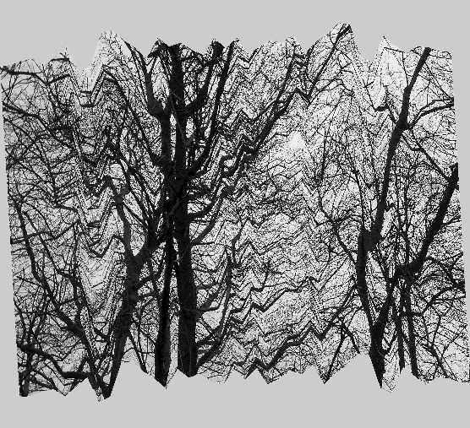

Surface deformation invariance

Slide 52

(cont’)
MFS on feature space

Slide 53


Slide 54

UIUC dataset
UMD
highresolution dataset

Slide 55

Comparison of classification
UIUC dataset (1000 images, 40 class)
Classification rate
vs
Training sample size
Zisserman et al (2003)
MFS on single-density func.
Ponce et al (2004)
MFS on multi-density func.

Slide 56

MFS on SIFT-like textons
Orientation histograms
Extension to motion texture
Code available at: http://www.cfar.umd.edu/~fer/website-texture/texture.htm

Slide 57
Example uses of texture in vision: analysis

Slide 58

Classifying materials, “stuff”
Figure by Varma & Zisserman
Kristen Grauman

Slide 59

Texture features for image retrieval
Y. Rubner, C. Tomasi, and L. J. Guibas. The earth mover's distance as a metric for image retrieval. International Journal of Computer Vision, 40(2):99-121, November 2000,
From K Grauman

Slide 60


Characterizing scene categories by texture
L. W. Renninger and J. Malik. When is scene identification just texture recognition? Vision Research 44 (2004) 2301–2311

Slide 61




Texture Synthesis [Efros & Leung, ICCV 99]

Slide 62


Synthesizing One Pixel
SAMPLE
x
sample image
Generated image
What is ?
Find all the windows in the image that match the neighborhood
consider only pixels in the neighborhood that are already filled in
To synthesize x
pick one matching window at random
assign x to be the center pixel of that window

Slide 63

Really Synthesizing One Pixel
SAMPLE
x
sample image
Generated image
An exact neighbourhood match might not be present
So we find the best matches using SSD error and randomly choose between them, preferring better matches with higher probability

Slide 64



Growing Texture
Starting from the initial image, “grow” the texture one pixel at a time

Slide 65





Window Size Controls Regularity

Slide 66









More Synthesis Results
Increasing window size

